Slide 1
Hadoop project
Created by Amit Kumar

Slide 2
This technology are used in this project
HDFS system
Hbase system
Pig
Hive

Slide 3
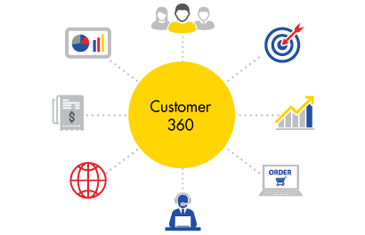
What is Customer 360
The 360-degree customer view is the idea, sometimes considered unattainable, that companies can get a complete view of customers by aggregating data from the various touch points that a customer may use to contact a company to purchase products and receive service and support
It is a strategic approach enabling businesses to offer the best customer experience across all channels, by allowing for a unified view of all customer touchpoints.

Slide 4
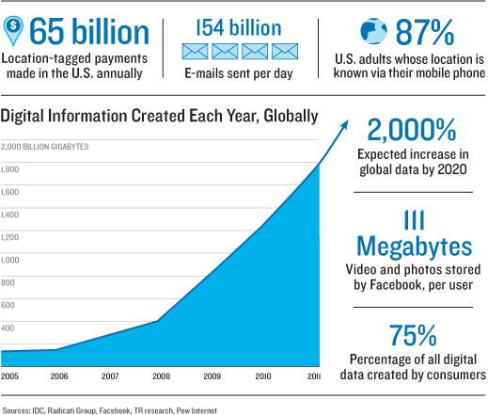
Why Hadoop for customer 360
Traditional Database management system are not capable of manging such amount of data
Big data hadoop has architecture to mange and capability to take such type of overhead
Its free and lots of industries are working on it .
Hadoop day by day are imprving their technology
and lots of people are working too improve day by day

Slide 5
Data sets
We are provided with 6 datasets,
Credit card: Credit card account details.
Credit card trx: Credit card trx details.
Demographics: Customer demographic details.
Deposit: Deposit account details.
Loan: Loan account details.
Savings: Savings account details.

Slide 6
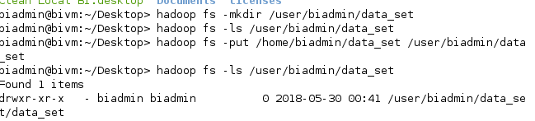
Hdfs system
Loading data to LFS to Hdfs
Start big insight
cd $BIGINSIGHTS_HOME/bin
./start-all.sh
Create directory on hdfs system ,
hadoop fs –ls /user/biadmin/data_set
Move data to fs to hdfs
hadoop fs –put /home/biadmin/data_set /user/biadmin

Slide 7
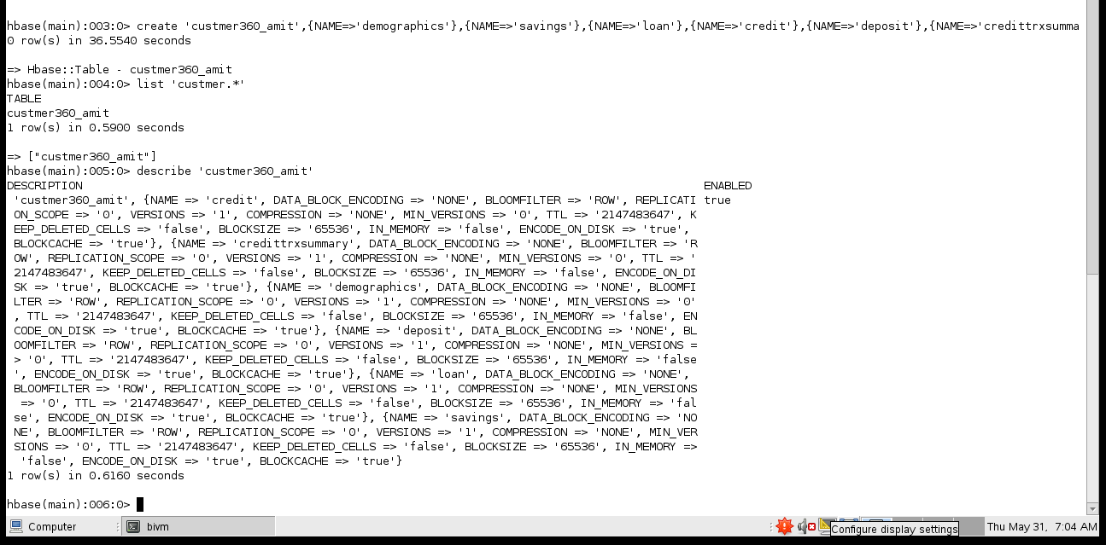
HBASE
Login to hbase ,
cd $HBASE_HOME/bin
./hbase shell
create table in hbase
create 'custmer360_amit',{NAME=>'demographics'},{NAME=>'savings'},{NAME=>'loan'},{NAME=>'credit'},{NAME=>'deposit'},{NAME=>'credittrxsummary'}
list 'custmer360.*'
describe 'custmer360_amit'

Slide 8
PIG
Login to pig,
cd $PIG_HOME/bin
./pig
There are diffrent data sets to put in hdfs system
Demographics.csv
Creditcard.csv
deposit account.csv
Loanaccount.csv
saving account.csv
Credttrxty.csv

Slide 9
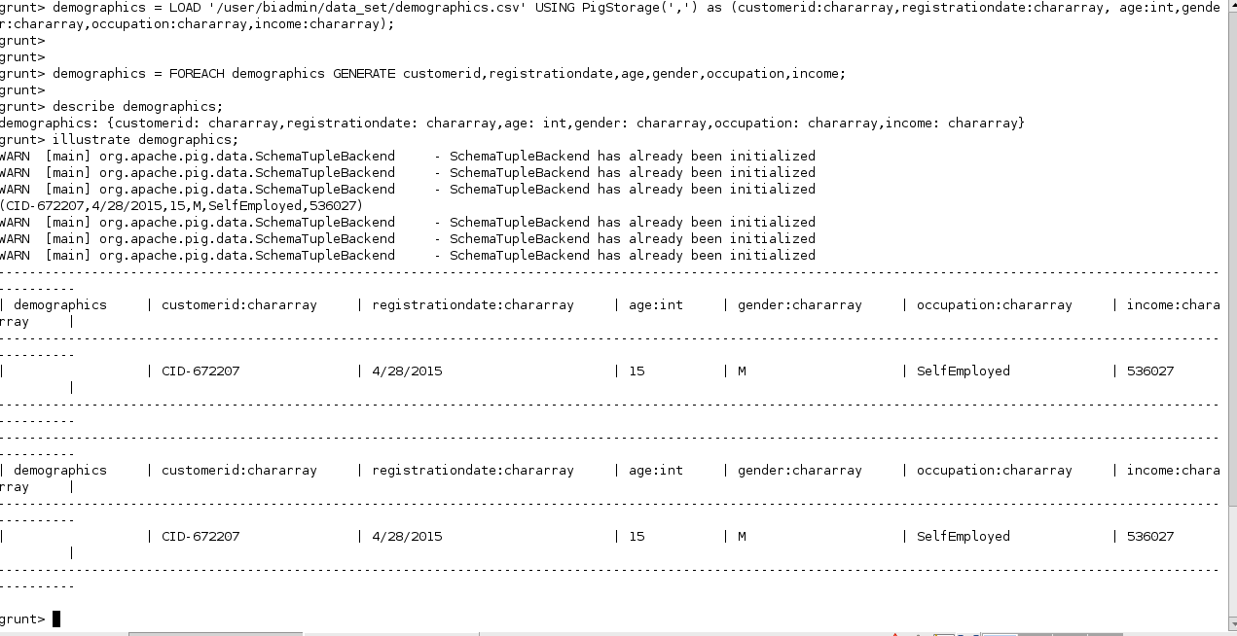
Demographics.csv
demographics = LOAD '/user/biadmin/data_set/demographics.csv' USING PigStorage(',') as (customerid:chararray,registrationdate:chararray, age:int,gender:chararray,occupation:chararray,income:chararray);
demographics = FOREACH demographics GENERATE customerid,registrationdate,age,gender,occupation,income;
describe demographics;
illustrate demographics;

Slide 10
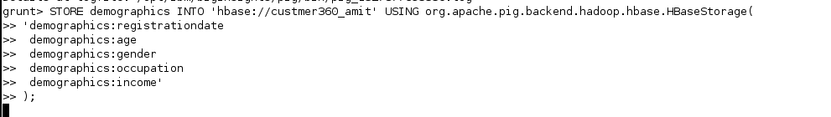
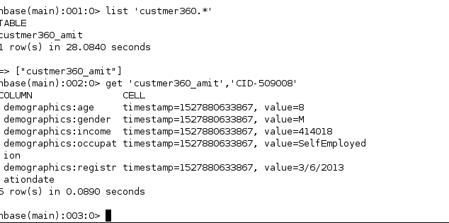
Demographics.csv
STORE demographics INTO 'hbase://custmer360_amit' USING org.apache.pig.backend.hadoop.hbase.HBaseStorage(
'demographics:registrationdate
demographics:age
demographics:gender
demographics:occupation
demographics:income'
);
HABSE-----
get 'custmer360_amit','CID-509008'
scan 'custmer360_amit',{LIMIT=>10}

Slide 11
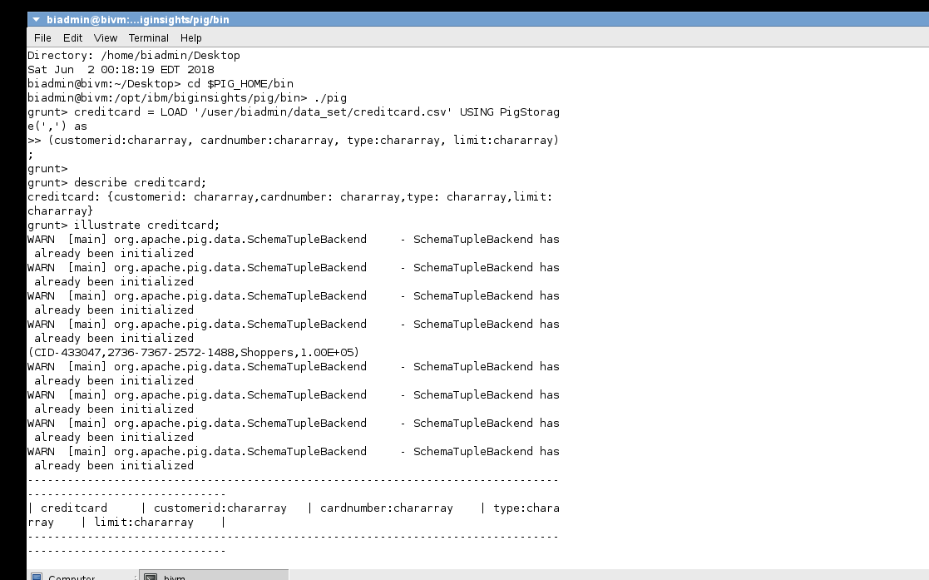
CREDITCARD
creditcard = LOAD '/user/biadmin/data_set/creditcard.csv' USING PigStorage(',') as
(customerid:chararray, cardnumber:chararray, type:chararray, limit:chararray);
describe creditcard;
illustrate creditcard;

Slide 12
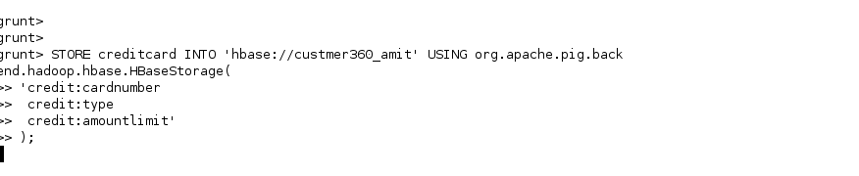
CREDITCARD
STORE creditcard INTO 'hbase://custmer360_amit' USING org.apache.pig.backend.hadoop.hbase.HBaseStorage(
'credit:cardnumber
credit:type
credit:amountlimit'
);
HBASE____
get 'custmer360_amit','CID-433047'
scan 'custmer360_amit',{LIMIT=>10}

Slide 13
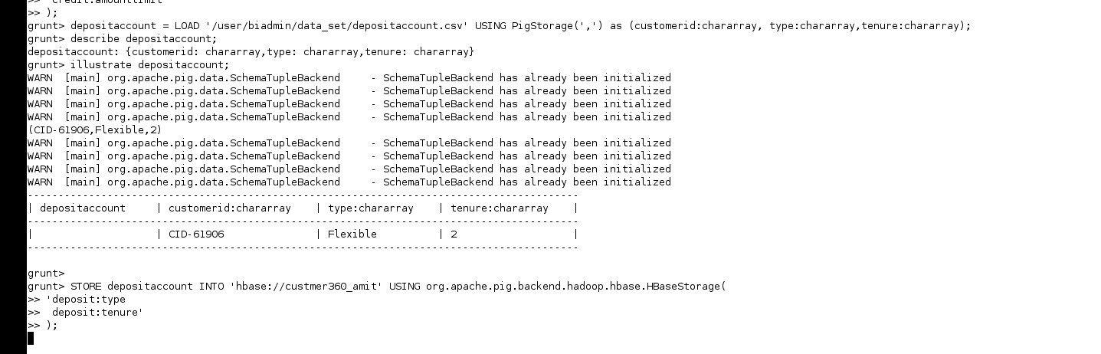
deposit account
depositaccount = LOAD '/user/biadmin/data_set/depositaccount.csv' USING PigStorage(',') as (customerid:chararray, type:chararray,tenure:chararray);
describe depositaccount;
illustrate depositaccount;
STORE depositaccount INTO 'hbase://custmer360_amit' USING org.apache.pig.backend.hadoop.hbase.HBaseStorage(
'deposit:type
deposit:tenure'
);

Slide 14
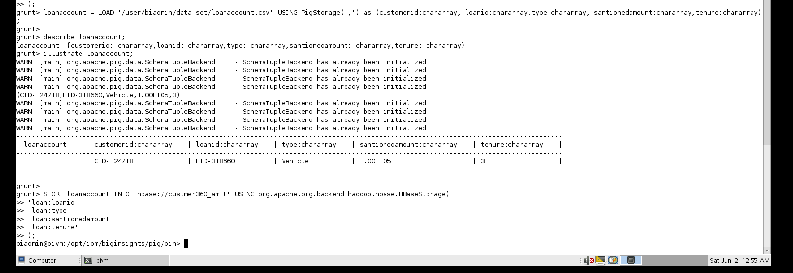
loanaccount
loanaccount = LOAD '/user/biadmin/data_set/loanaccount.csv' USING PigStorage(',') as (customerid:chararray, loanid:chararray,type:chararray, santionedamount:chararray,tenure:chararray);
describe loanaccount;
illustrate loanaccount;
STORE loanaccount INTO 'hbase://custmer360_amit' USING org.apache.pig.backend.hadoop.hbase.HBaseStorage(
'loan:loanid
loan:type
loan:santionedamount
loan:tenure'
);

Slide 15
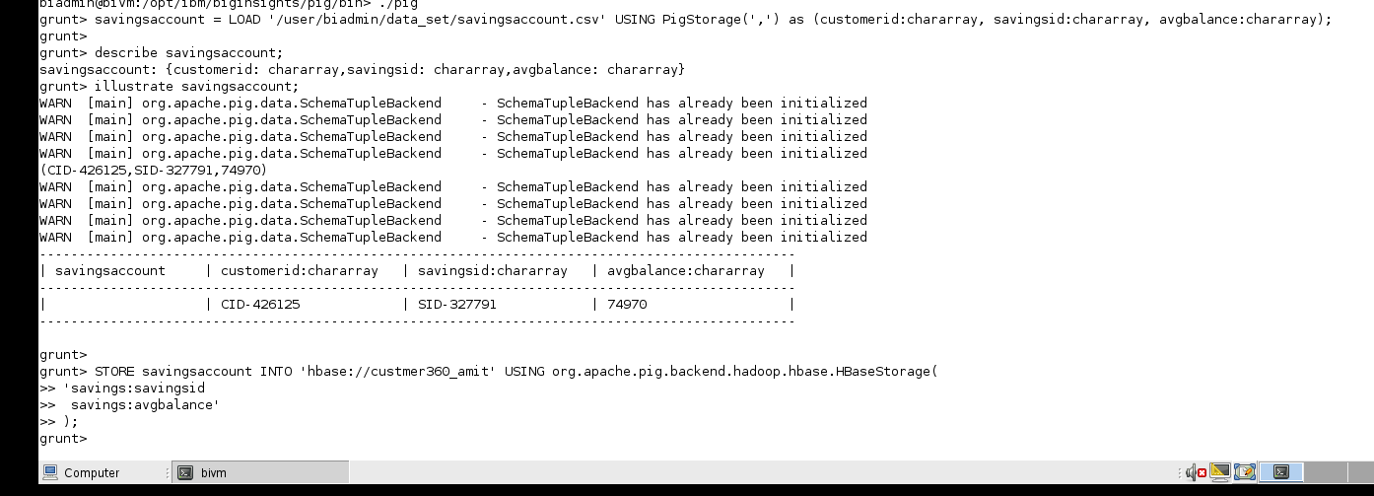
SAVING ACCOUNT
savingsaccount = LOAD '/user/biadmin/data_set/savingsaccount.csv' USING PigStorage(',') as (customerid:chararray, savingsid:chararray, avgbalance:chararray);
describe savingsaccount;
illustrate savingsaccount;
STORE savingsaccount INTO 'hbase://custmer360_amit' USING org.apache.pig.backend.hadoop.hbase.HBaseStorage(
'savings:savingsid
savings:avgbalance'
);

Slide 16
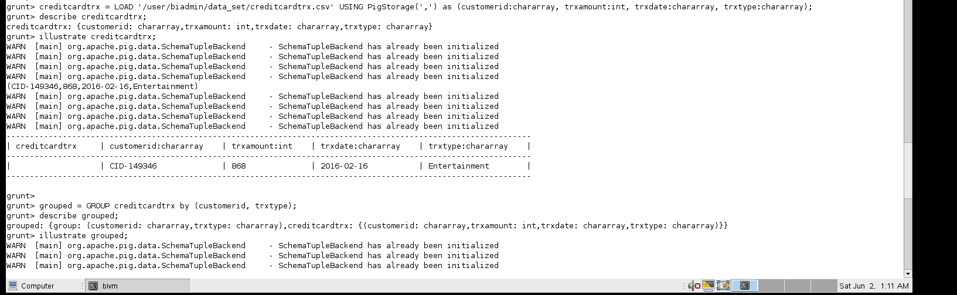
credttrxty
creditcardtrx = LOAD '/user/biadmin/data_set/creditcardtrx.csv' USING PigStorage(',') as (customerid:chararray, trxamount:int, trxdate:chararray, trxtype:chararray);
describe creditcardtrx;
illustrate creditcardtrx;
grouped = GROUP creditcardtrx by (customerid, trxtype);
describe grouped;
illustrate grouped;

